Slide 1
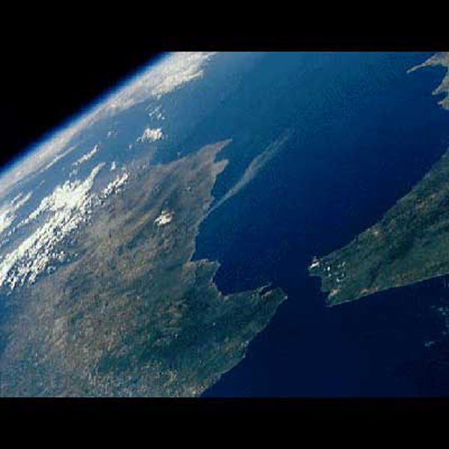
Phil & Maretta Barr
Sharing the Gospel in Southern Spain
MALAGA, SPAIN

Slide 3
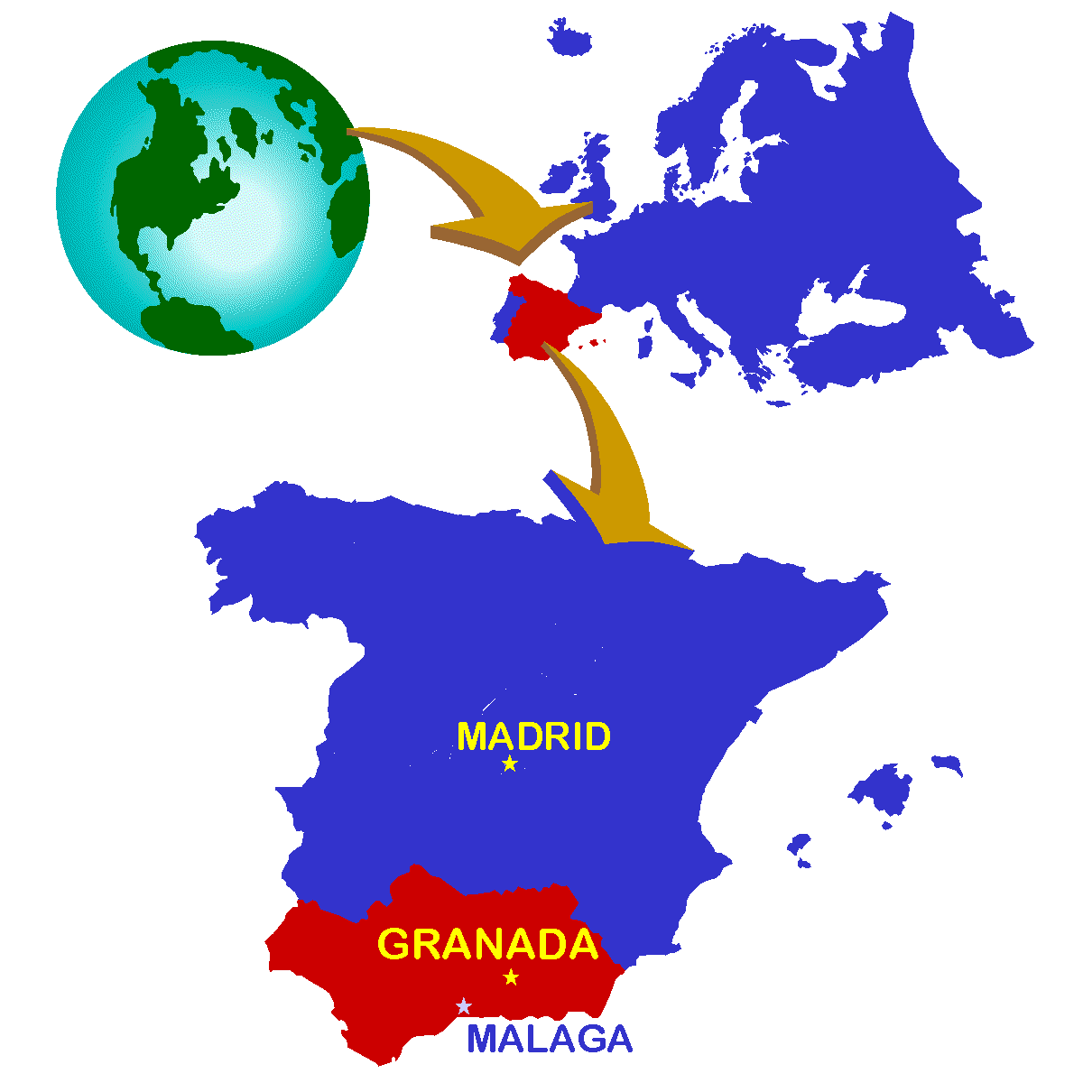
WHERE ARE WE WORKING?
FINISTERRE
BARCELONA
POPULATION - 42 MILLION
CAPITAL – MADRID
NEEDS-
O.O5% EVANGELICALS
MORE THAN 7,000 TOWNS without any witness
MORE THAN 1 MILLION
STUDENTS without the Lord
SEVILLA

Slide 4
Spain: Traditional Religion with Modern Secularism
SPIRITUAL SCHIZOPHRENIA
3rd COUNTRY LEGALIZING HOMOSEXUAL MARRIAGES
ABORTION LEGAL FOR OVER 35 YEARS
15% SELF - PROCLAIMED AGNOSTICS
COMPLETE IGNORANCE OF THE BIBLE
ONLY 14% OF YOUNG PEOPLE “RELIGIOUS”

Slide 5
On Easter Sunday,
there are no processions
going out…
…the focus is on
the passion of Christ but not
the Risen Christ...

Slide 6
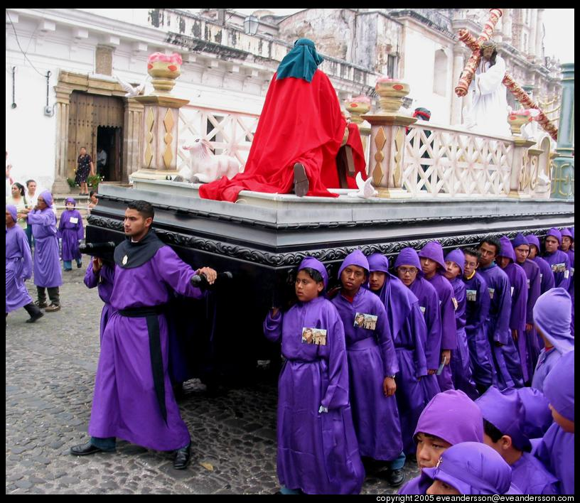
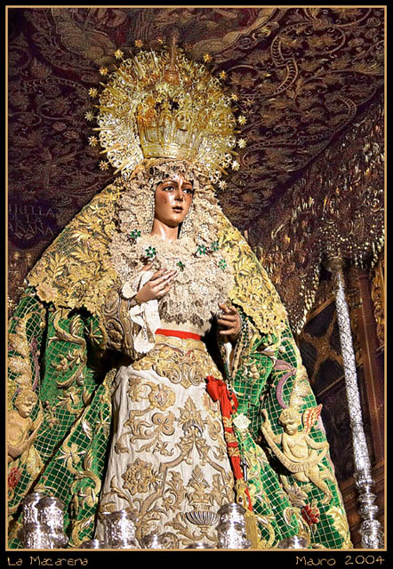
HOLY WEEK
WITHOUT
RESURRECTION!

Slide 7
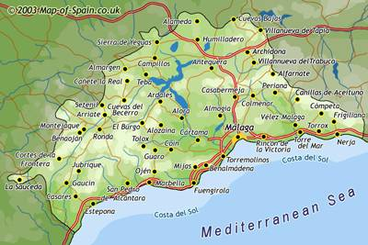
OUR VISION AND CALL
Our vision is to partner with fellow evangelicals in southern Spain to reach the surrounding secular culture.

Slide 8
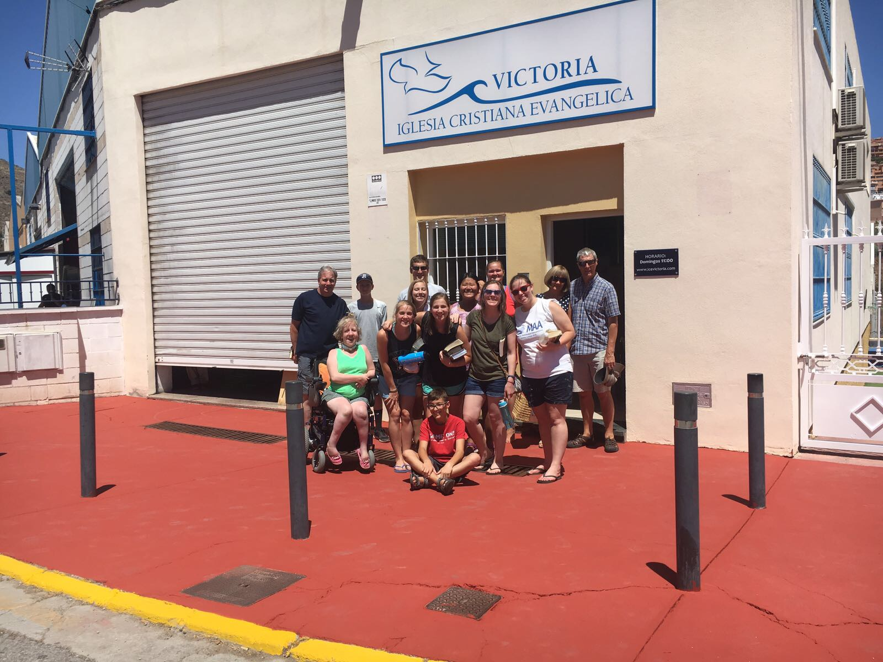
We are partnering with Victoria Evangelical Church in Rincon de la Victoria

Slide 9
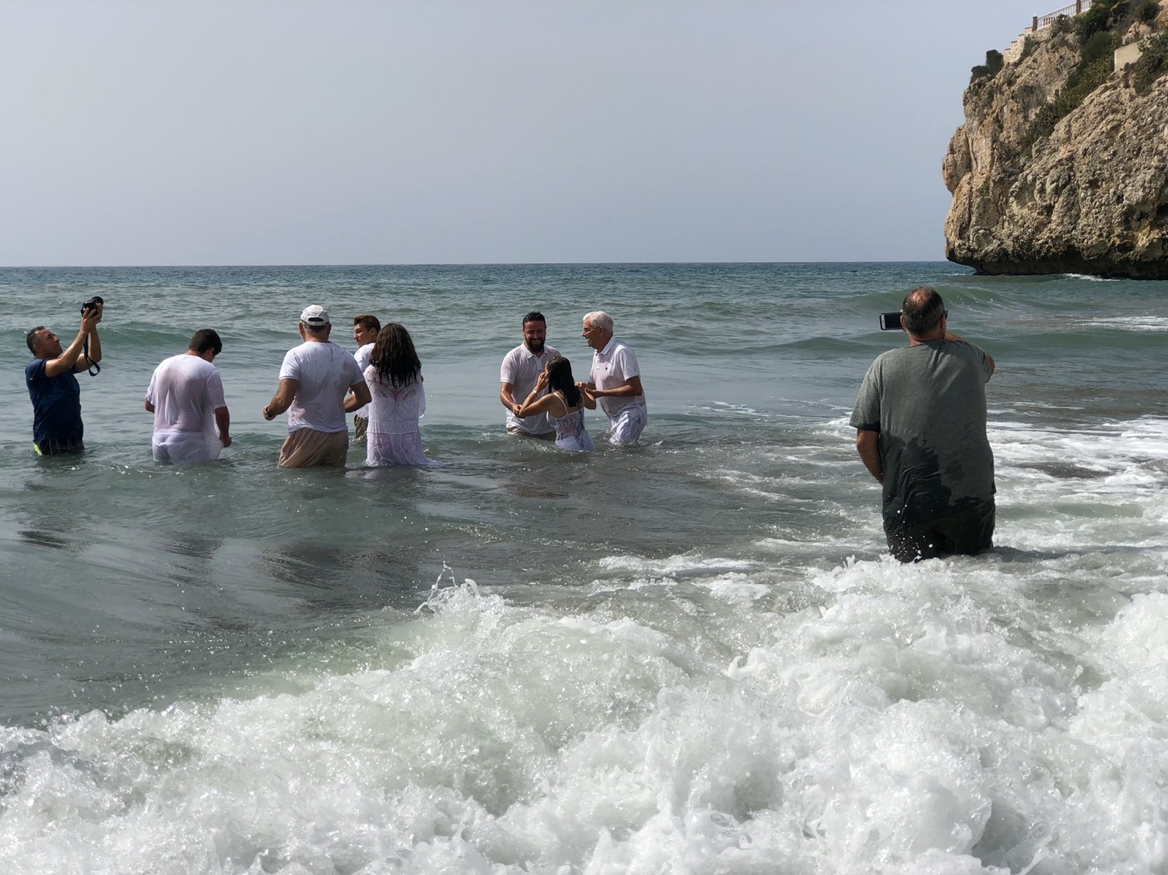
Recent Baptism of New Believers

Slide 10
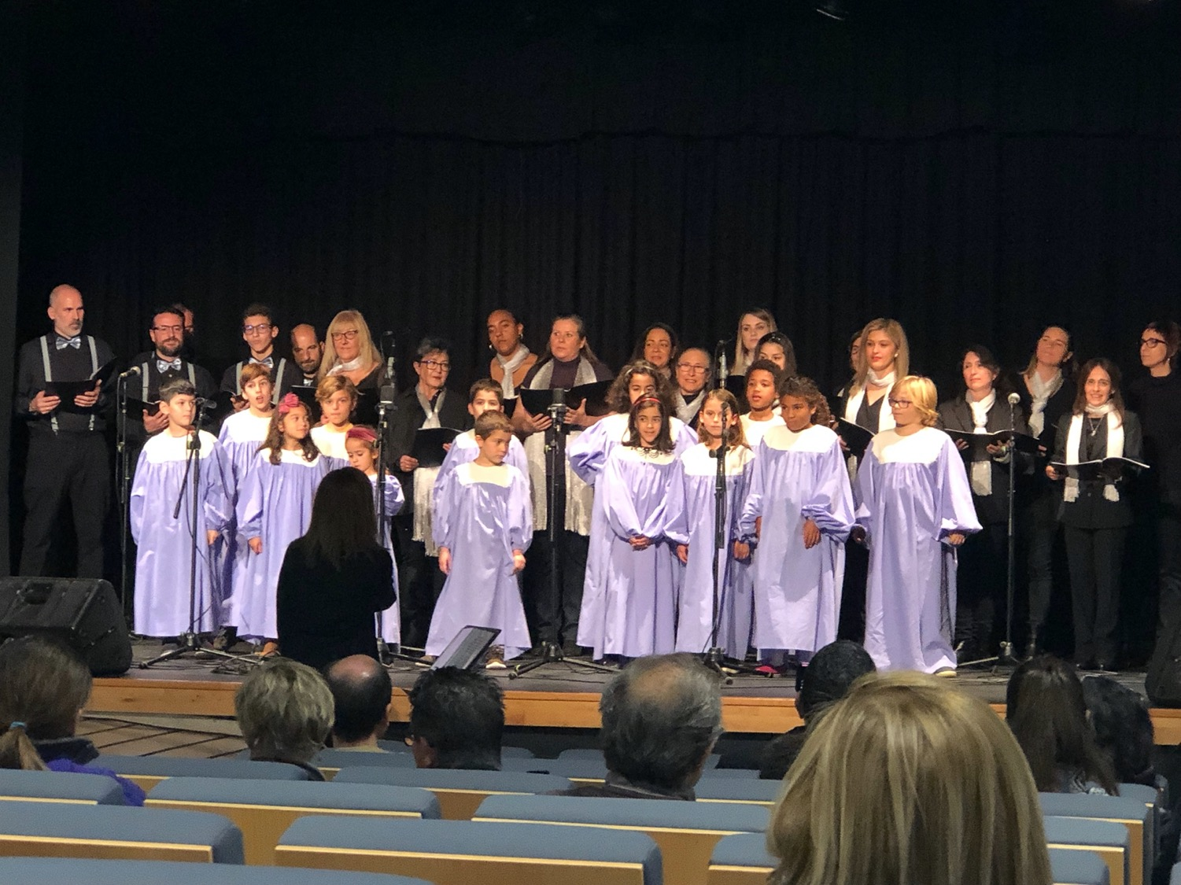
Sharing the Gospel Message through Song

Slide 11
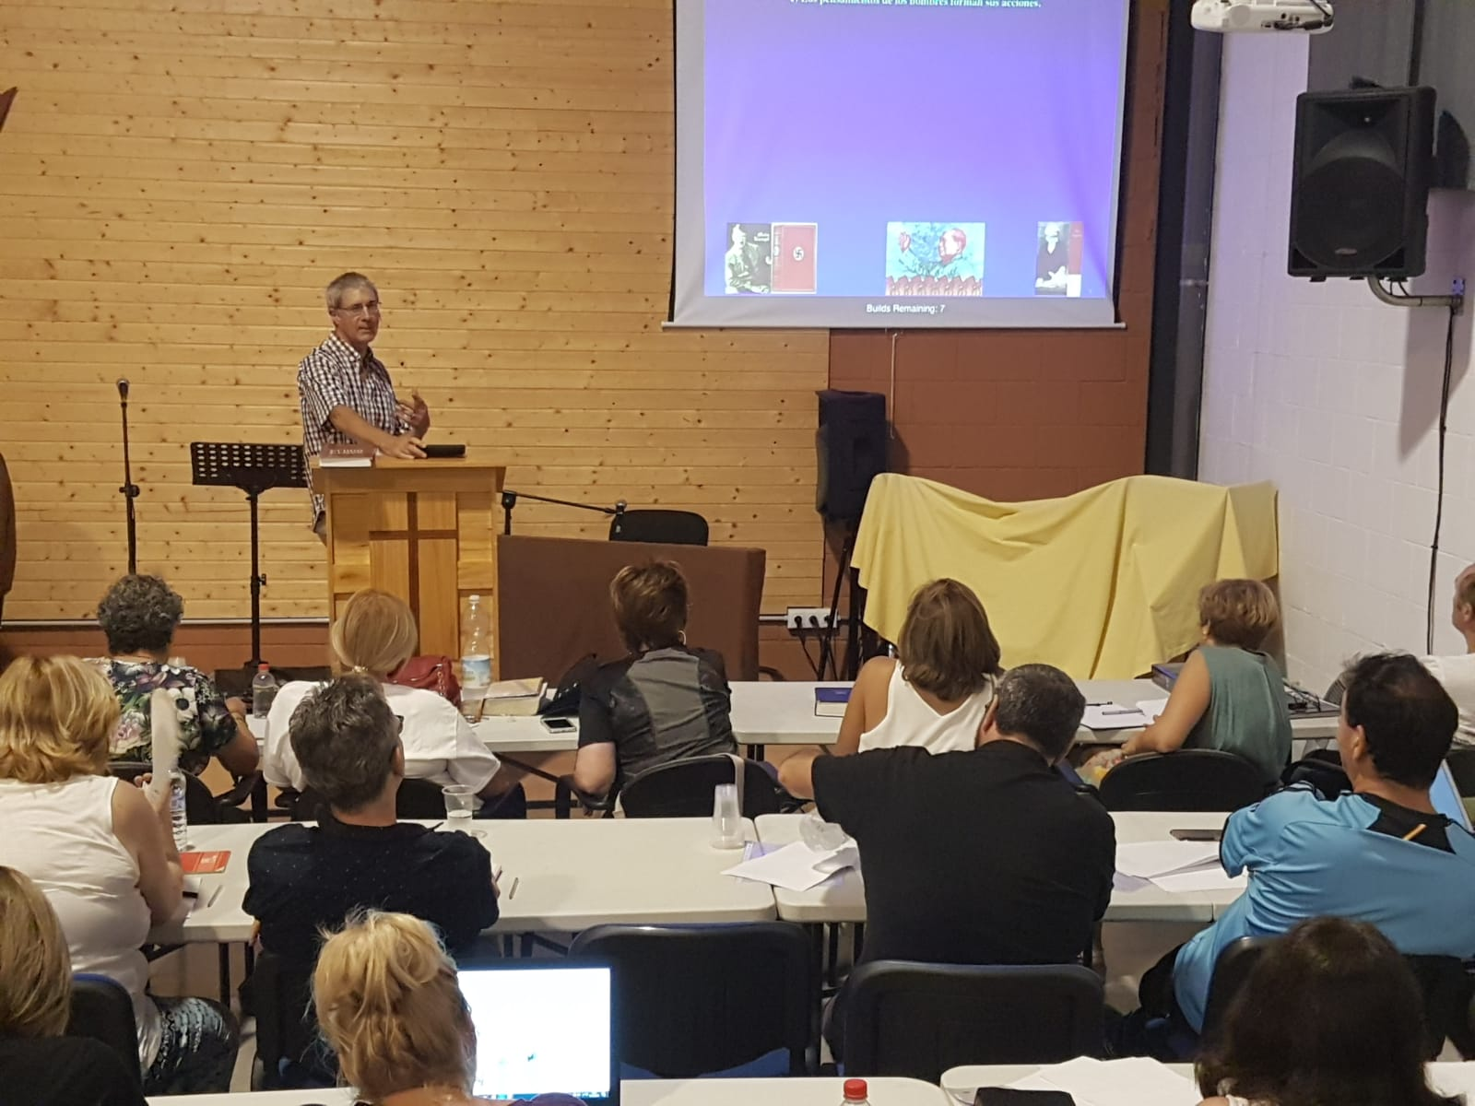
Phil teaching Bible Doctrine

Slide 12
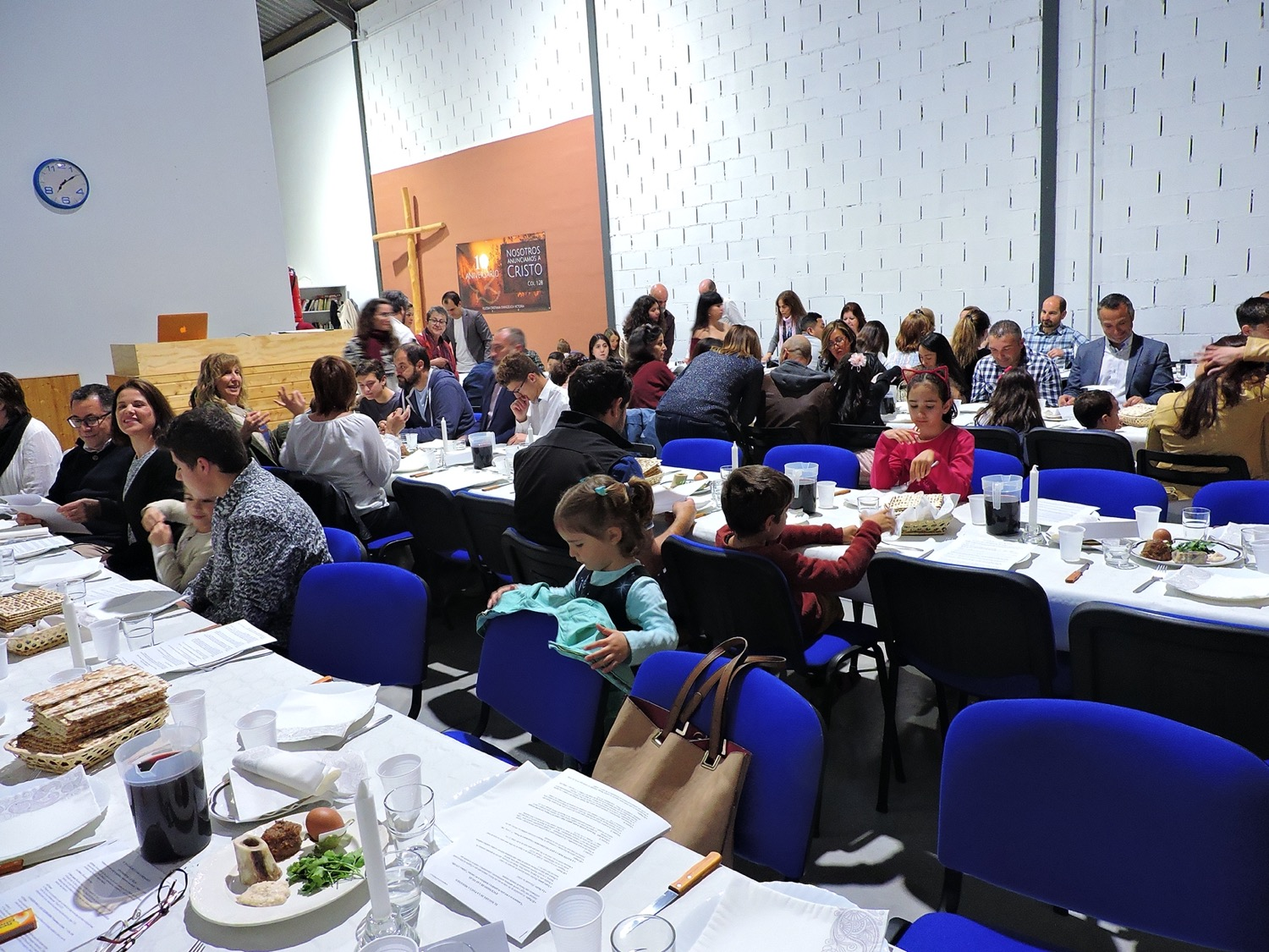
We recently hosted a Messianic Passover Service at the church

Slide 13
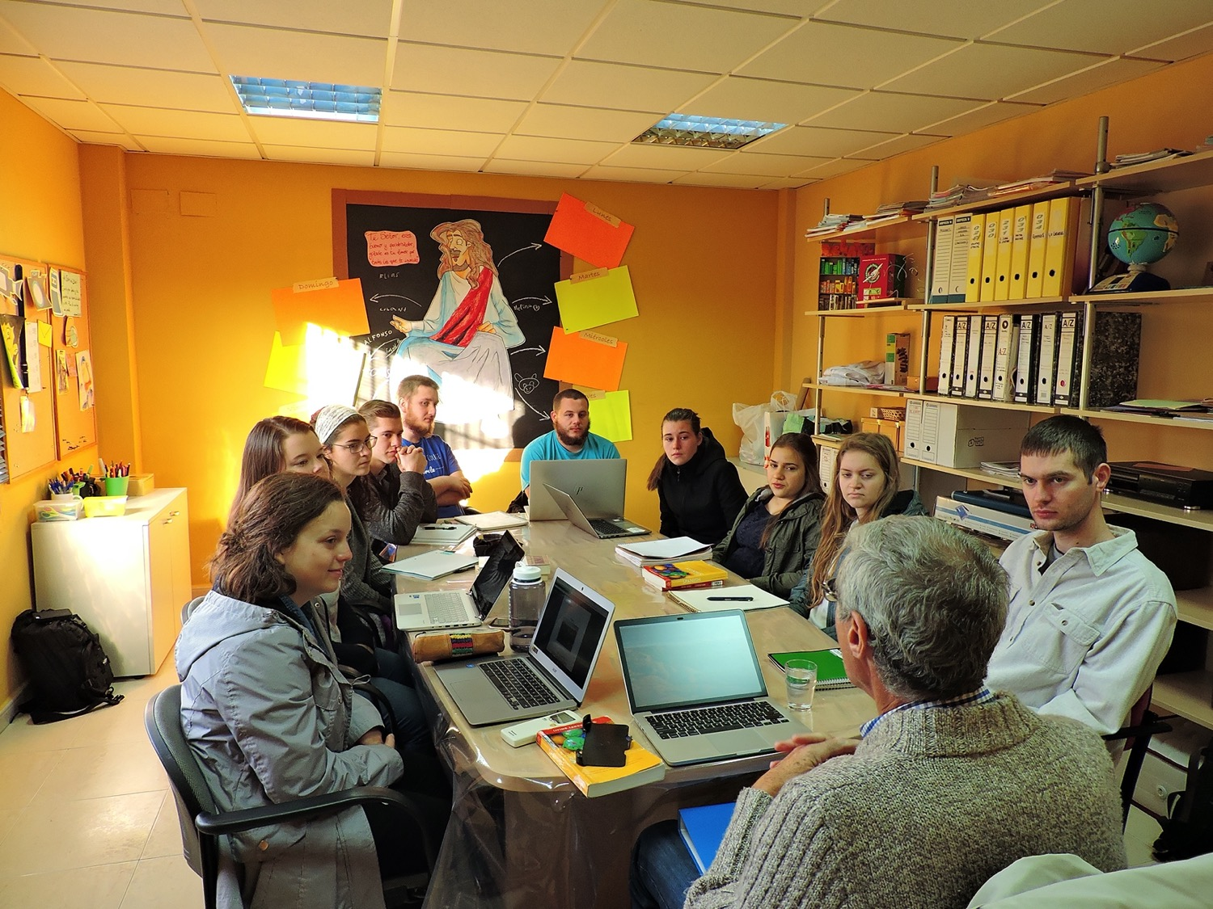
Hosting an RBC Cross-Cultural Study Term in Spain

Slide 14
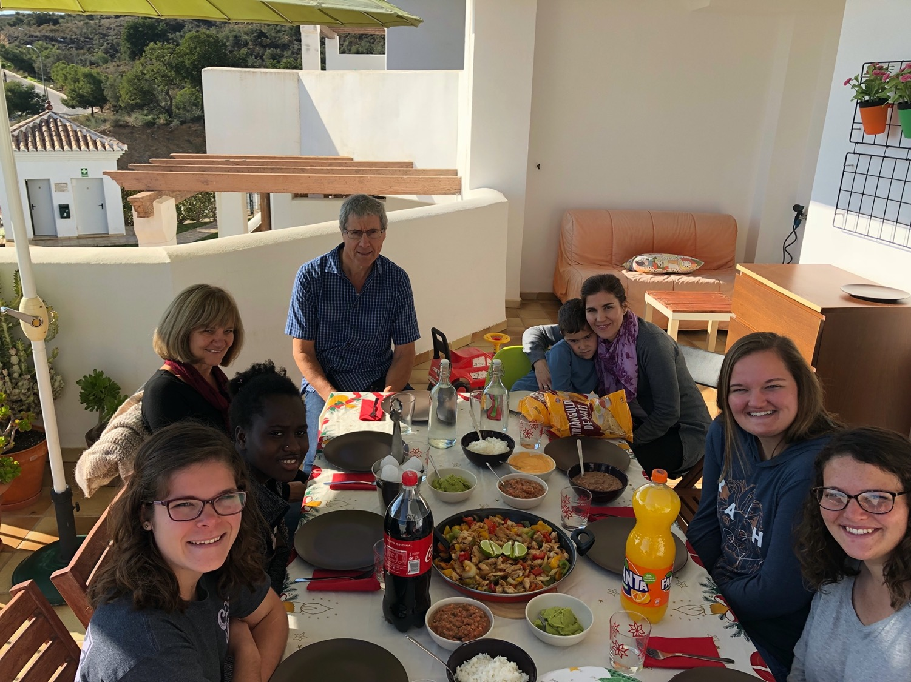
Hosting REACH Teams with the help of the Victoria Church

Slide 15
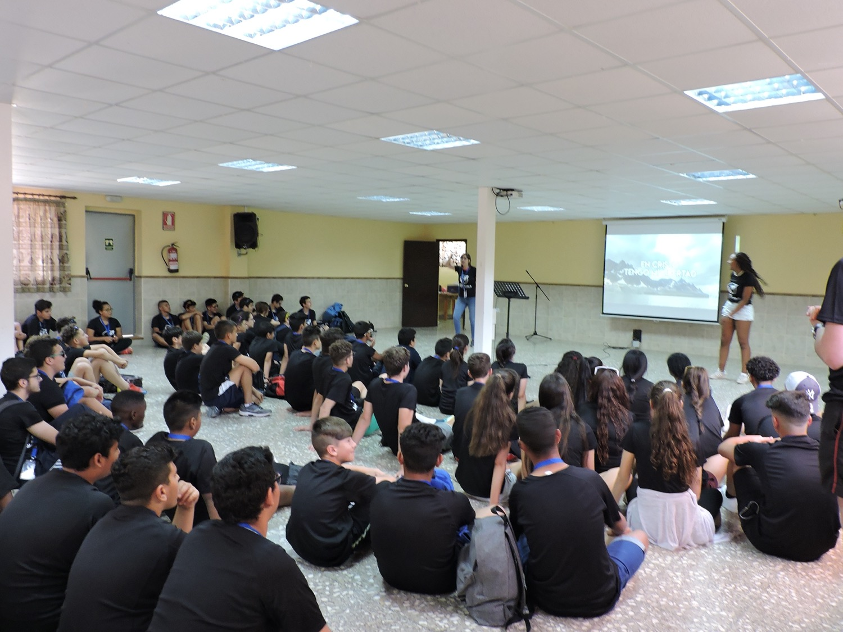
Encouraging Evangelical Students from the secular schools of the region

Slide 16
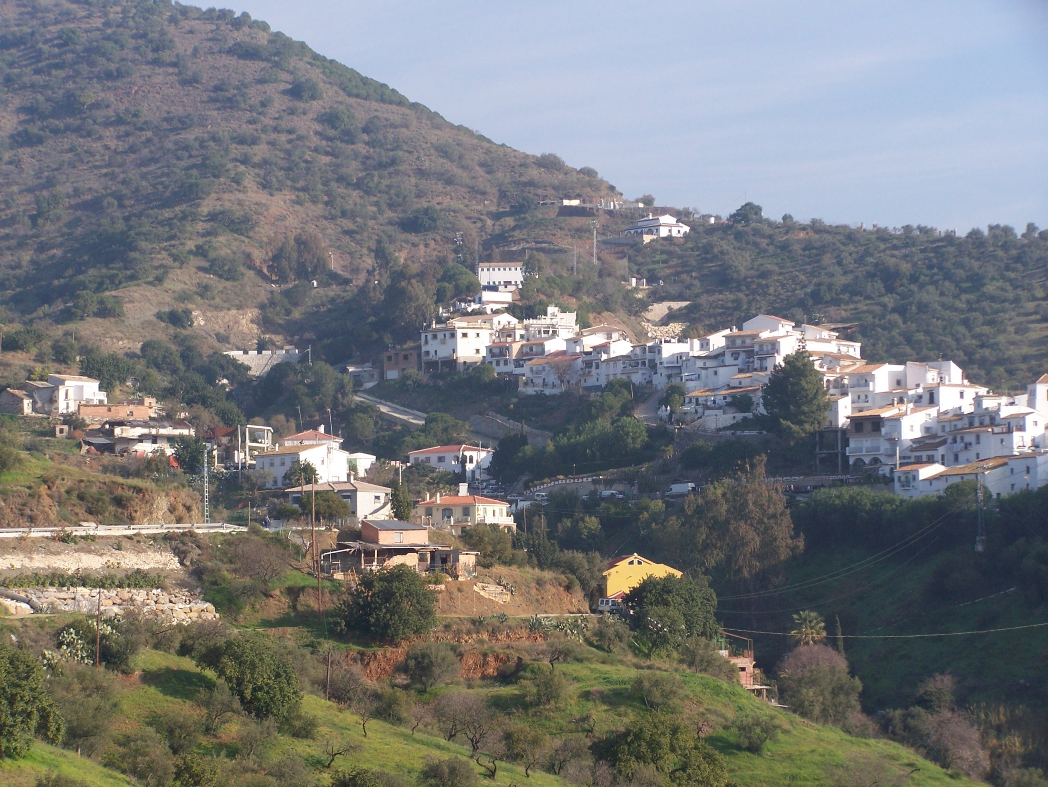
Over 7,000 municipalities without a Gospel Witness
(Evangelical Group/Church)

Slide 17
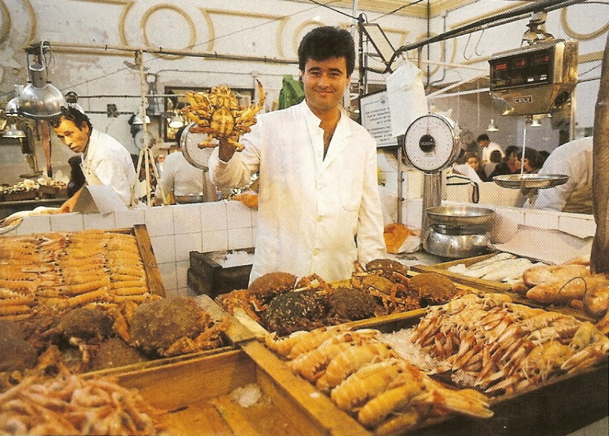
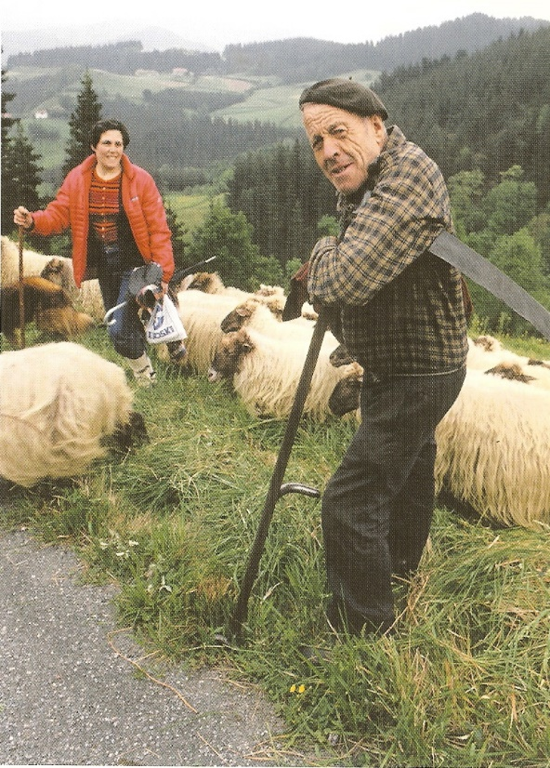
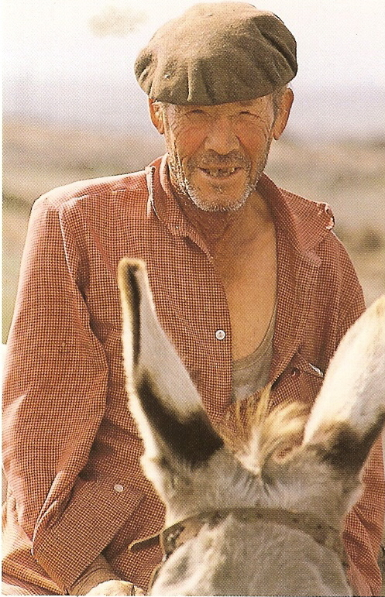
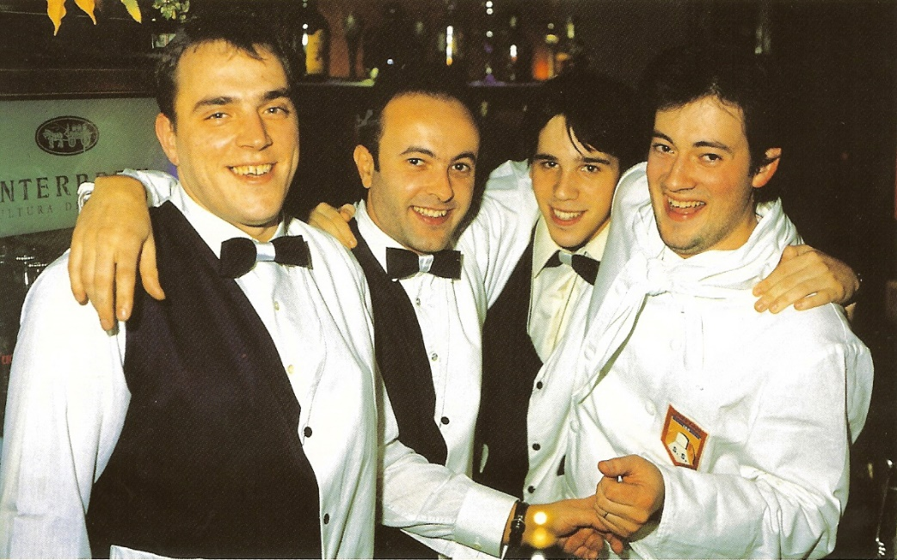
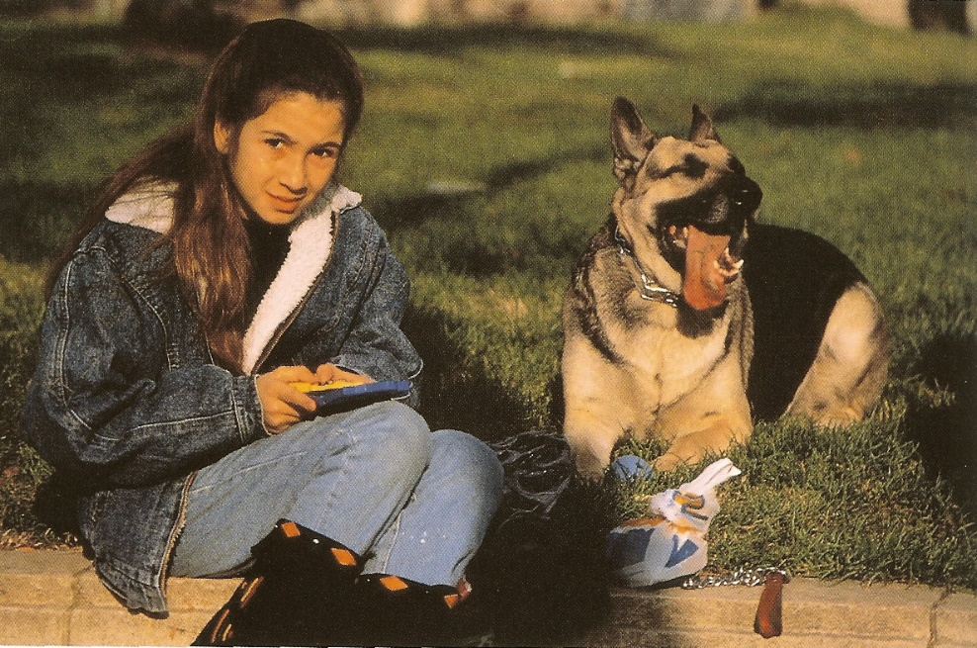
Fanning the Flame
of the Gospel of Grace
In Southern Spain

Slide 18
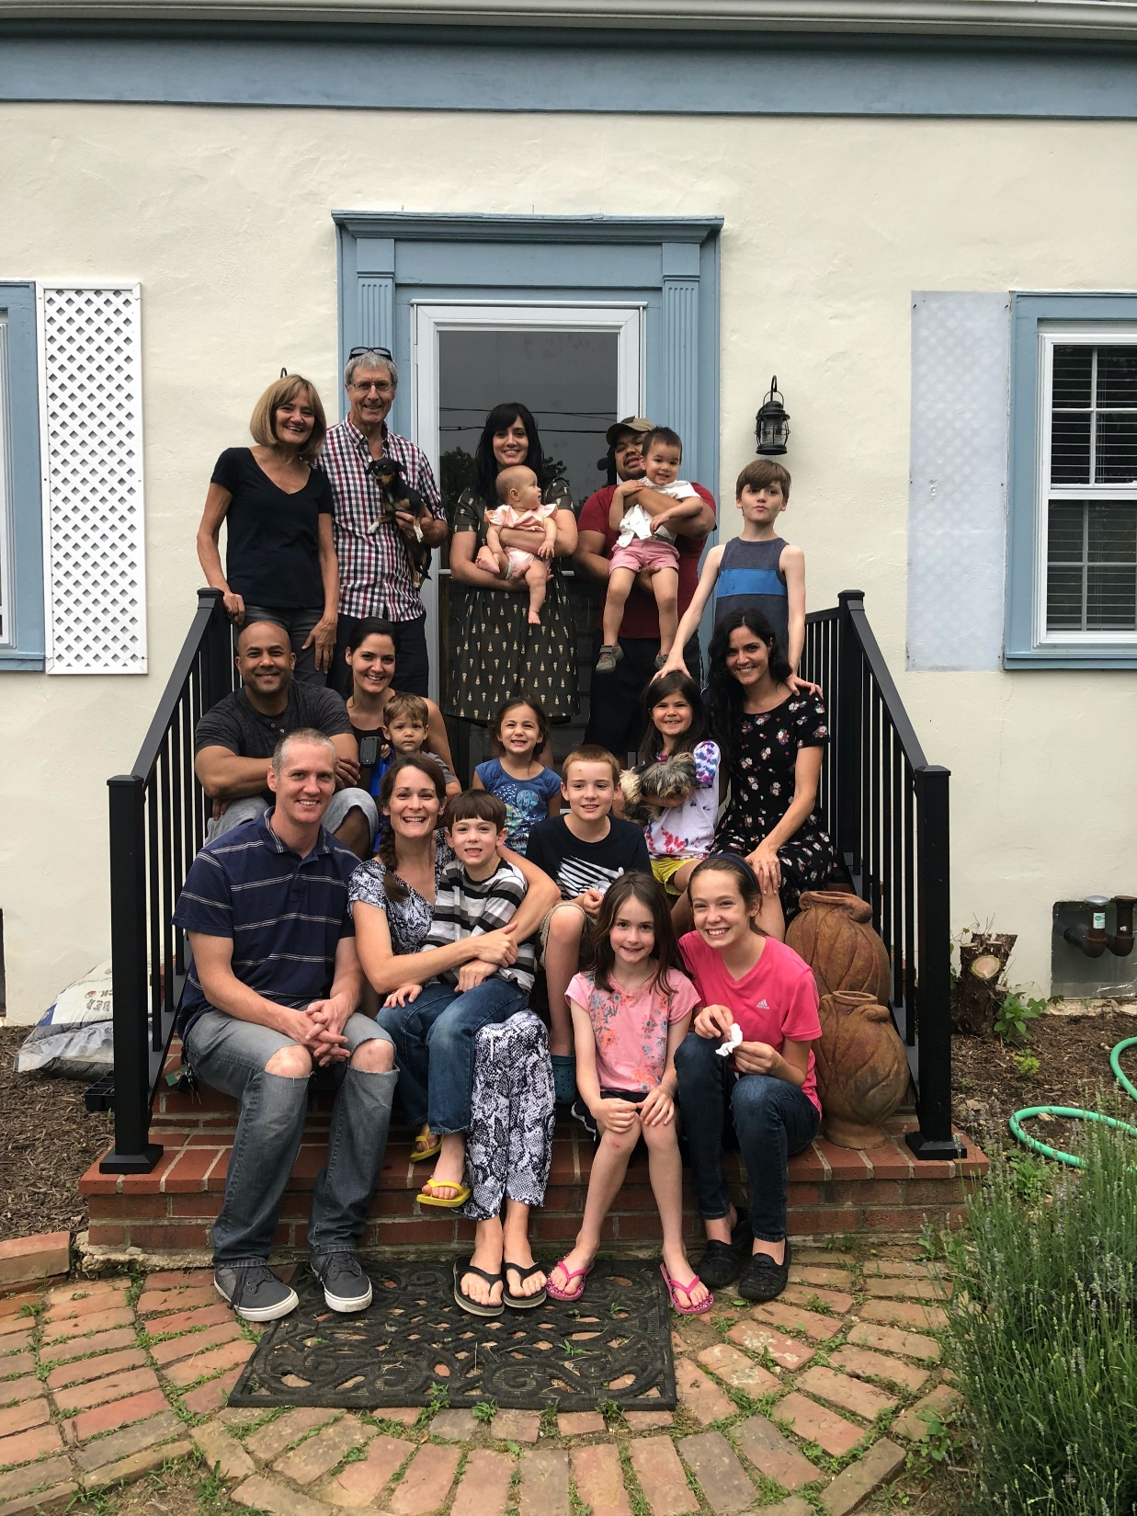
Part of the family we leave behind

